Slide 1
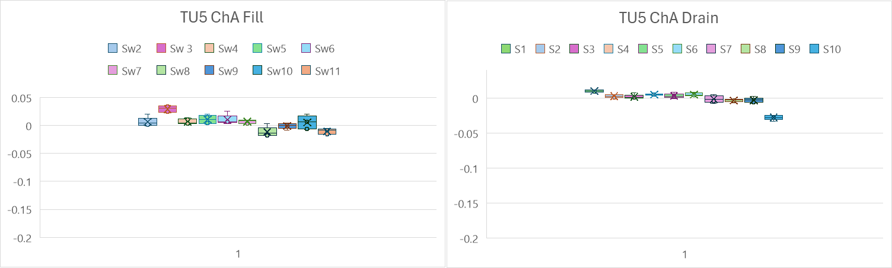
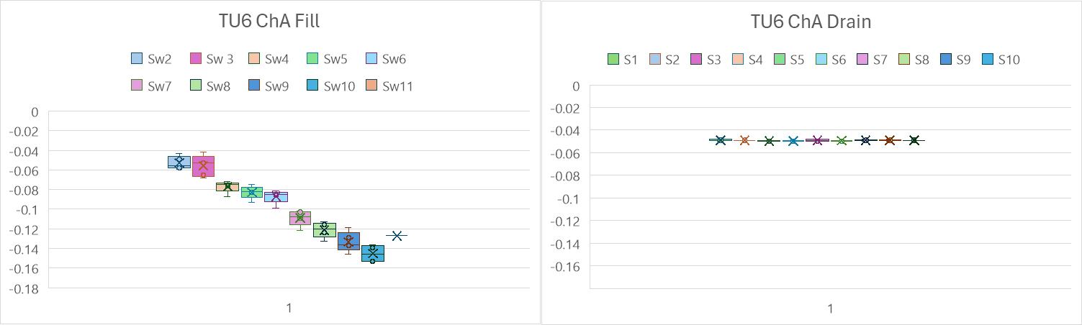
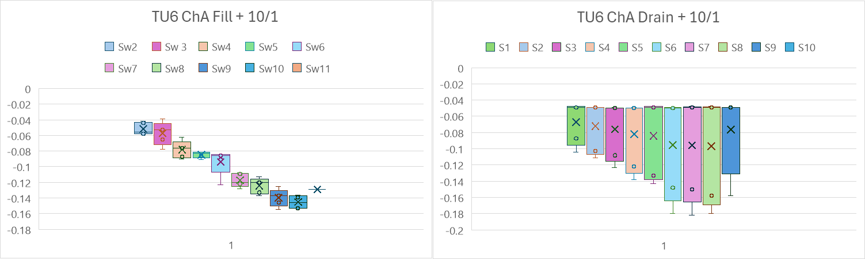

Slide 2
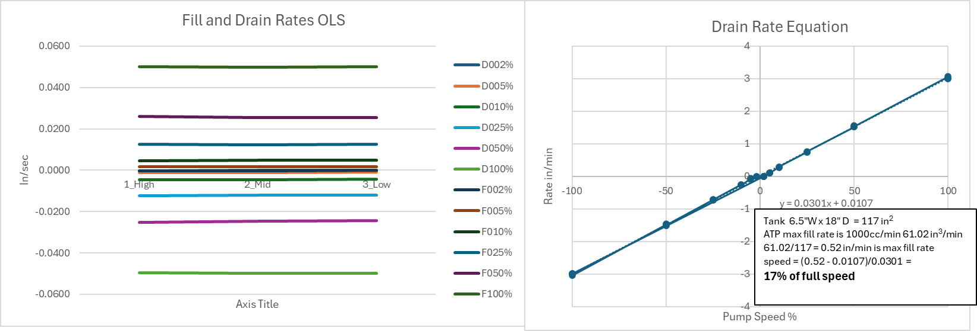
PWC OLS Level Test Tank
ATP Target Rate
42 measurement at 7”, 5” 3” as High, Med, Low
D= Drain; F=Fill followed by % of full speed.
Regression on all 42 points
Fills slightly slower than it Drains.

